Slide 1
Credit Score Classification
Data Programming
Mohammad Haris
Dipak Bhattarai
Shakiba Mashini
Reihaneh Moghisi
Vaishnavi Chilumuru
Nov 29, 2023

Slide 2
OUTLINE
•Overview and objective
•Exploratory Data Analysis
•Preprocessing
•Missing Value
•Outliers
•Label encoding
•Feature Selection
•Model Construction
•Evaluation Metrics
•Cross Validation
•Hyper Parameter Tuning

Slide 3
Problem Statement

Slide 4
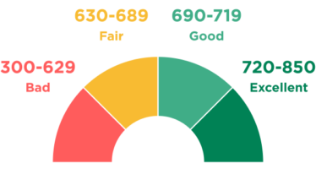
Objective:
Data of a global finance company.
Over the years, the company has collected basic bank details and gathered a lot of credit-related information.
The management wants to build an intelligent system to segregate the people into credit score brackets to reduce the manual efforts.
Our study aims to analyze the trends and details of client demographic and financial information within a financial institution. Subsequently, this data will be utilized to predict credit scores.
This Photo by Unknown Author is licensed under CC BY-NC

Slide 5


Dataset Columns Overview
100k rows, 28 columns
1. Demographic Information: Name, Age, SSN, Occupation
2. Financial Profile: Annual-Income,
Monthly-Inhand-Salary
Bank Accounts: Num-Bank-Accounts
Credit Cards: Num-Credit-Card
Loans: Num-of-Loan, Type-of-Loan
3. Credit Behavior: Payment History: Delay-from-due-date, Num-of-Delayed- Payment Credit Inquiries: Num-Credit-Inquiries Credit Mix: Different types of credit accounts Outstanding Debt: Outstanding-Debt Credit Utilization: Credit-Utilization-Ratio Credit-History-Age 4. Payment Details: Minimum Payment: Payment-of-Min-Amount EMI: equated monthly installment payment Investment: Amount-invested-monthly Monthly Balance: Monthly-Balance 5. Target Variable: Credit-Score

Slide 6
Exploratory Data Analysis

Slide 7
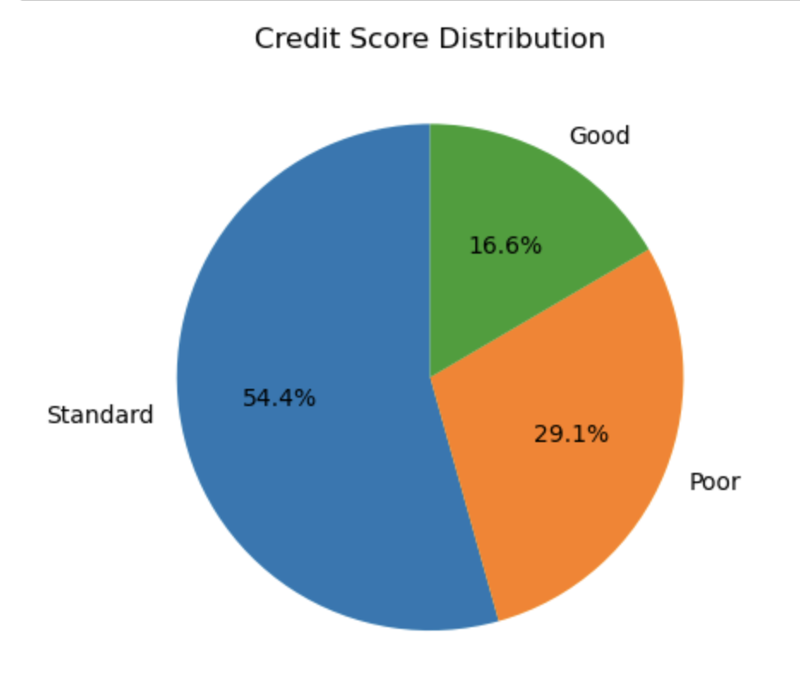
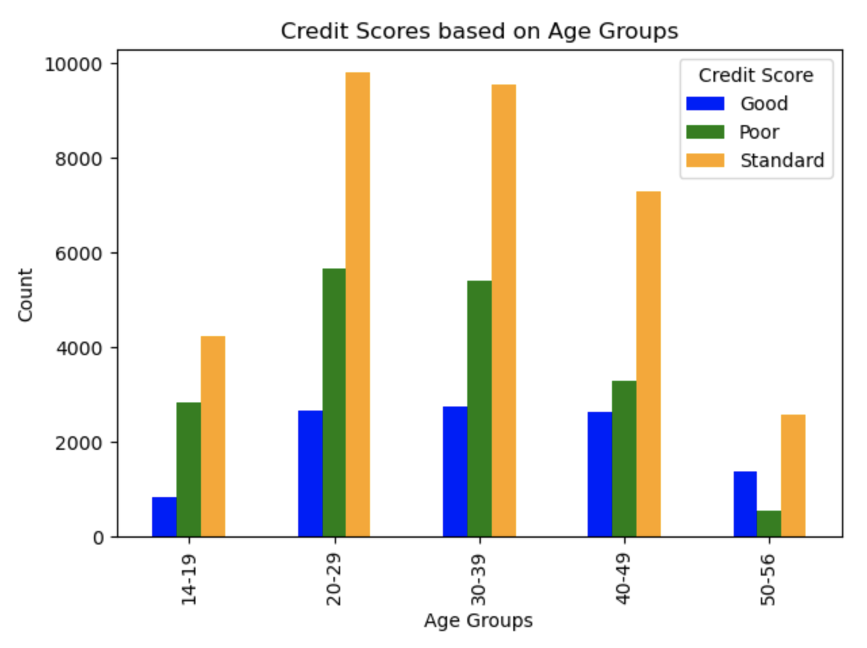
Credit Score by Age Group

Slide 8
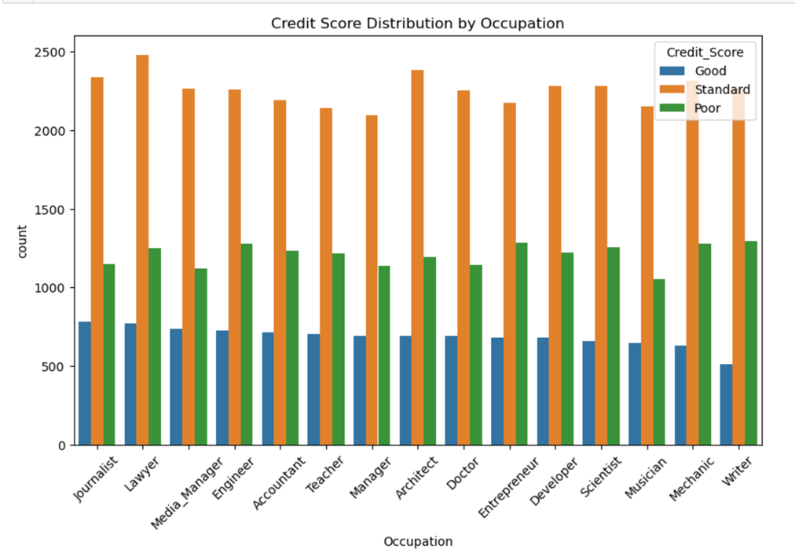
Credit Score for Occupation
‘Good’ Creditors:
Journalists highest number of Good Credit Score
Writers have lowest number of Good credit Scores
Doctors, Architect, Managers are in the middle

Slide 9
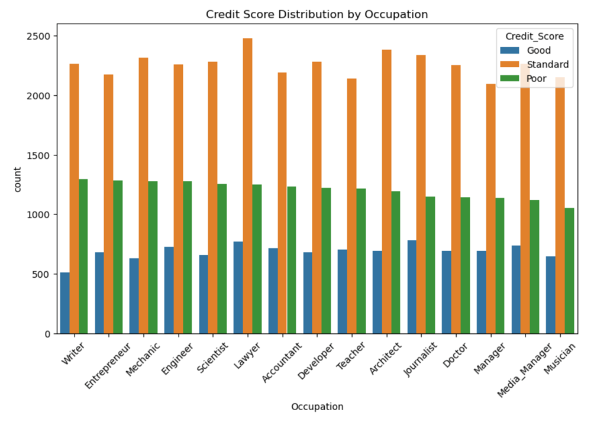
Credit Score for Occupation
’Poor’ creditors:
Writers have highest number of Poor credit Scores
Musicians have lowest number of Poor credit scores
Managers, Doctors, Architects have proportionally low number of Poor credit scorers

Slide 10
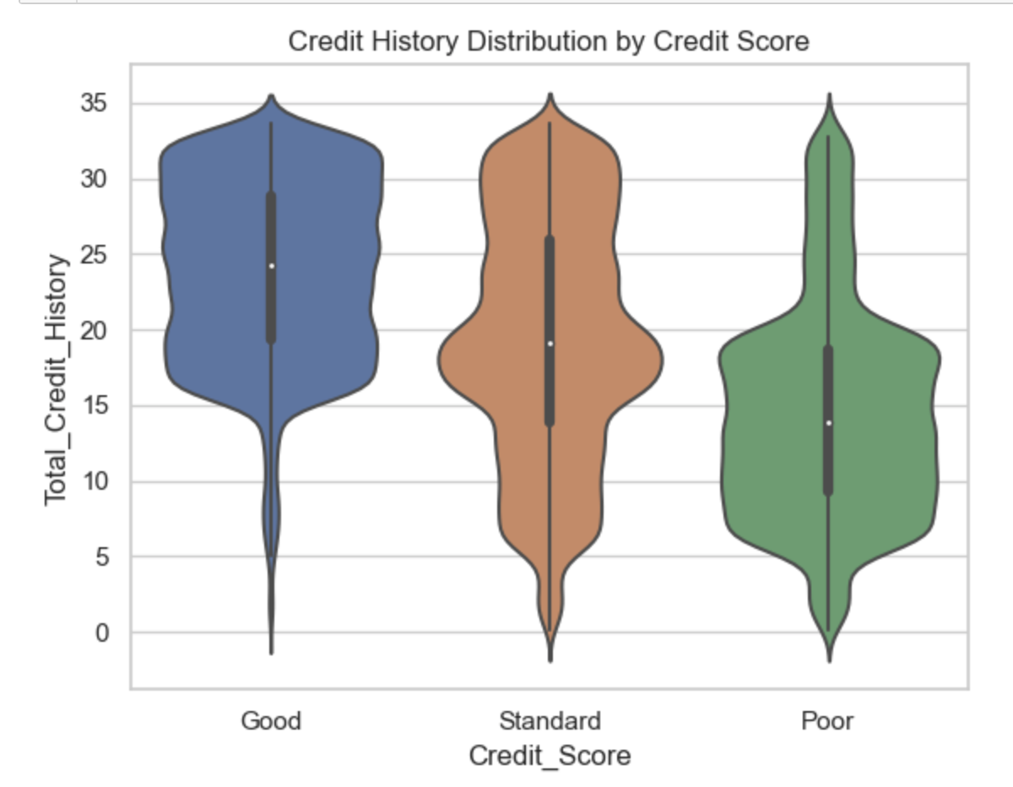
Credit History (years) vs Credit Scores
Creditworthy individuals have extended years of credit history
15 to 35 years
Poor credit scorers have shorter credit history
5 to 20 years
Standard credit scorers have expanded history in years ranging from
5 years 32 years
The average credit history in total is 15 years

Slide 11
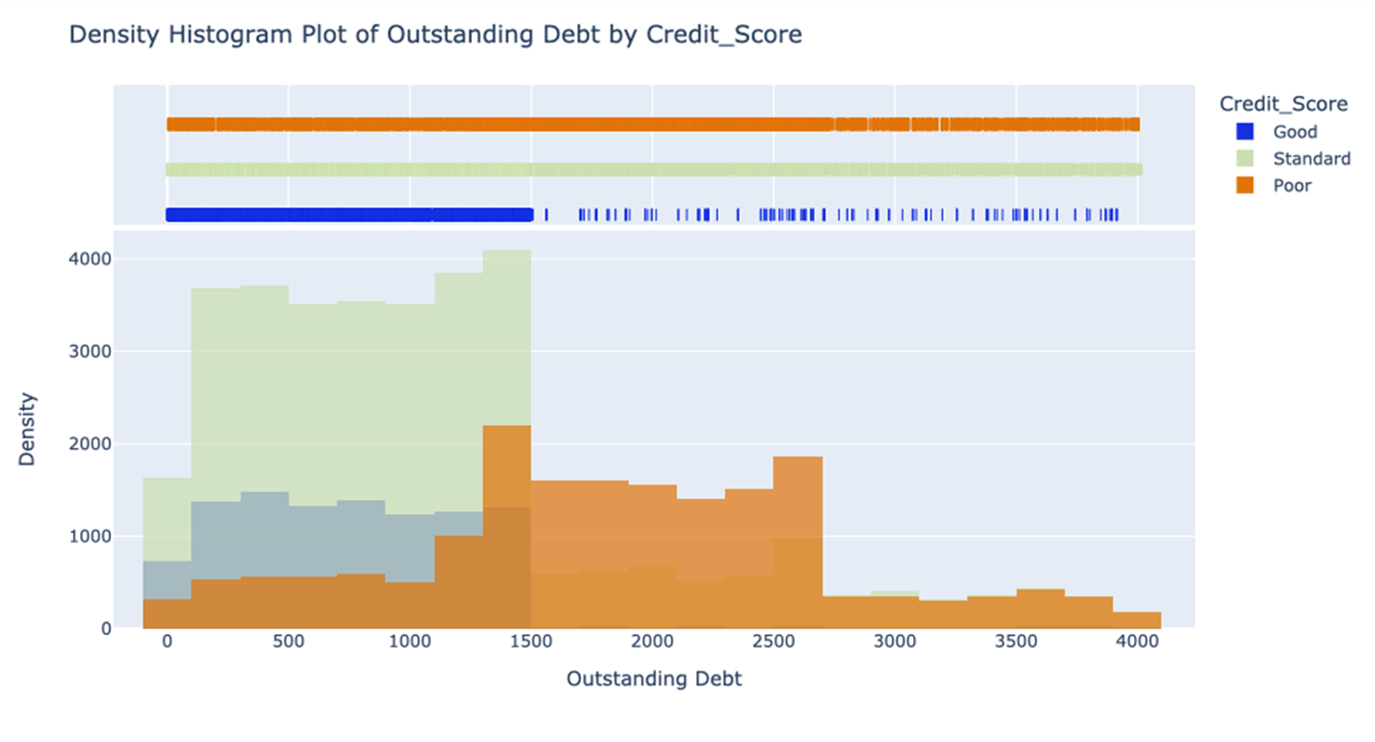
Outstanding Debt vs. Credit Score
Outstanding Debt have high importance in prediction of credit_score (from feature selection algorithm)
Individuals with Good credit_score have lower outstanding debt, It cuts off at 1700$

Slide 12
Preprocessing

Slide 13
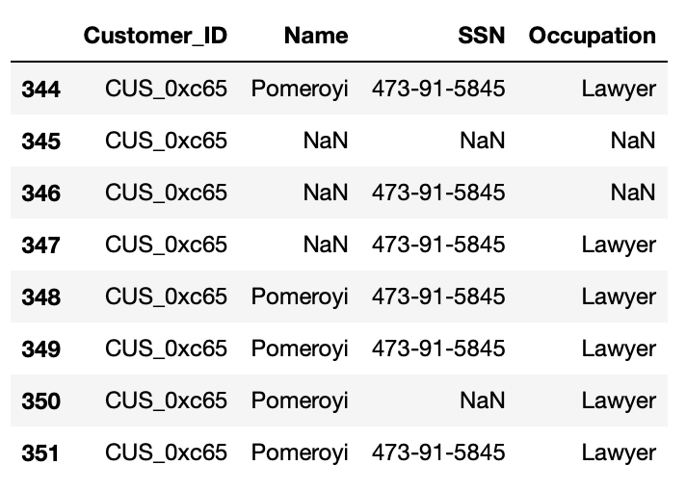
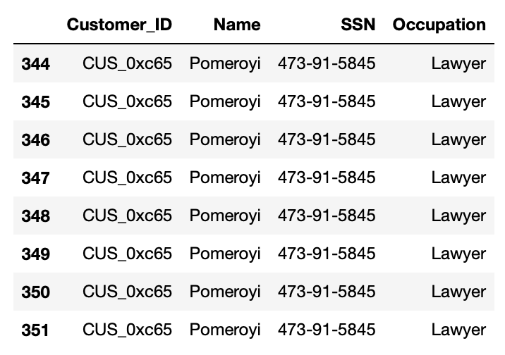


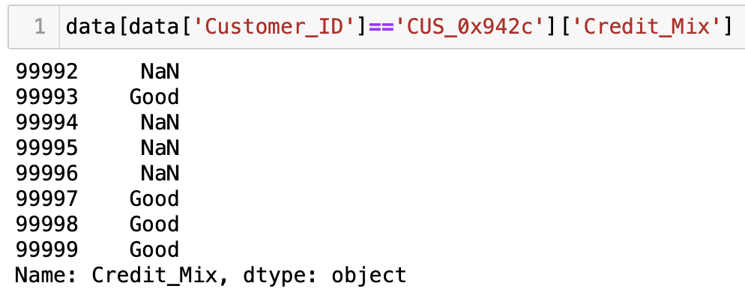
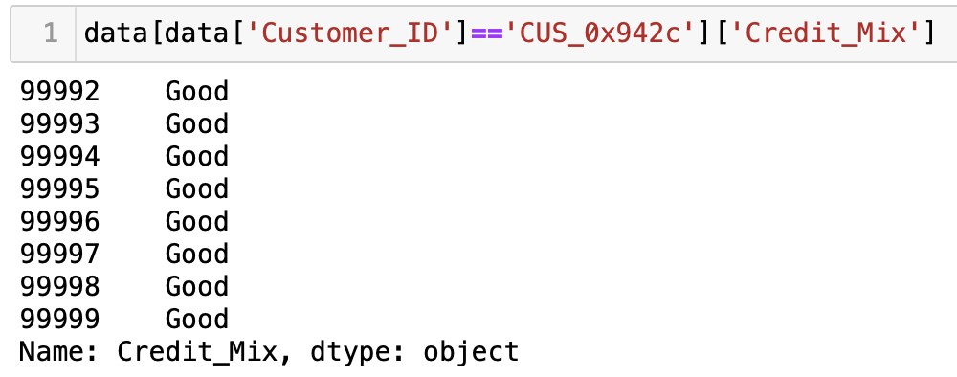
Missing Value Handling
Data includes multiple records from each customer.
Trying to retrieve missing values from available information of same customer (Exact value, mean, mode)
Replace with exact Value
2. Replace with Mode

Slide 14
Outliers
Method Used to Handle Outliers
Numerical Features in the data
- Age
- Annual Income
- Monthly In-hand Salary
- Num Bank Accounts
- Num Credit Card
- Interest Rate
- Num of Loan
- Delay from due date
- Num of Delayed Payment
- Changed Credit Limit
- Num Credit Inquiries
- Outstanding Debt
- Credit Utilization Ratio
- Total EMI per month
- Amount invested monthly
- Monthly Balance
Grouping features by Customer_ID
Mean/ Mode
Calculate Group Modes
Replacing Extreme Values with NaN
Filling NaN with Group Mode and Overall Mean

Slide 15

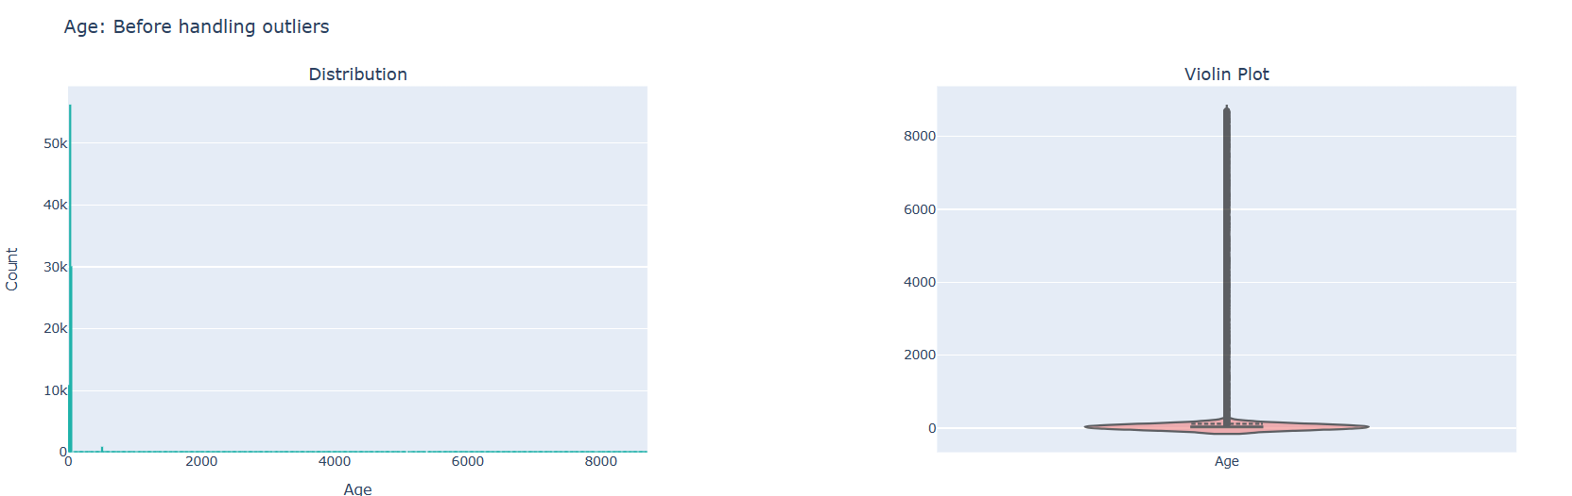
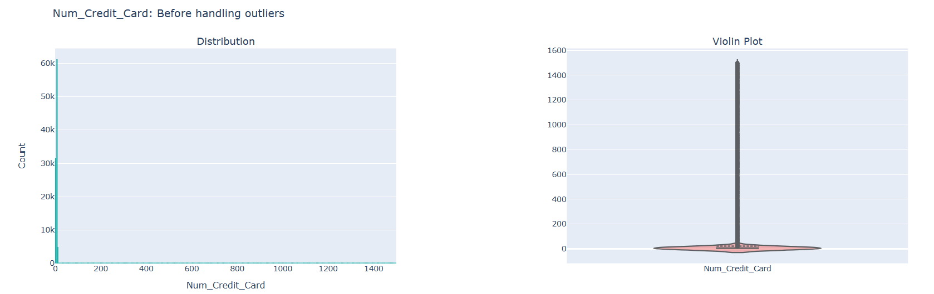
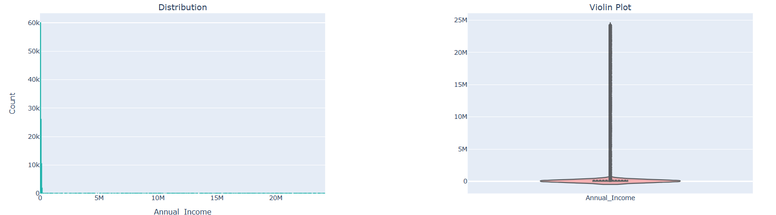
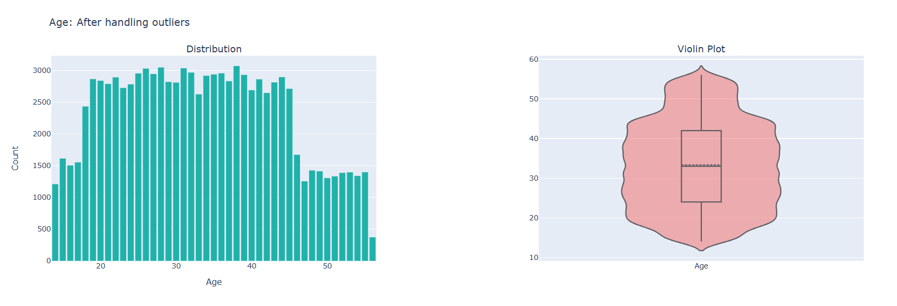
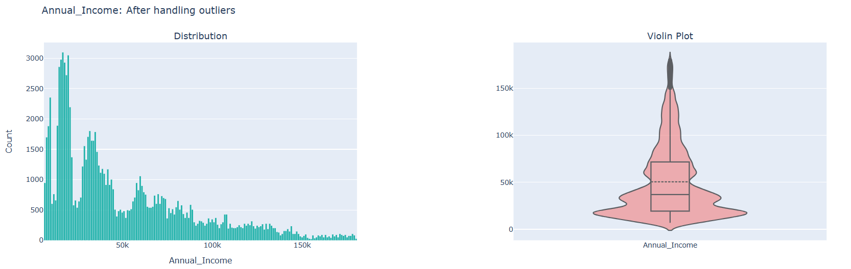
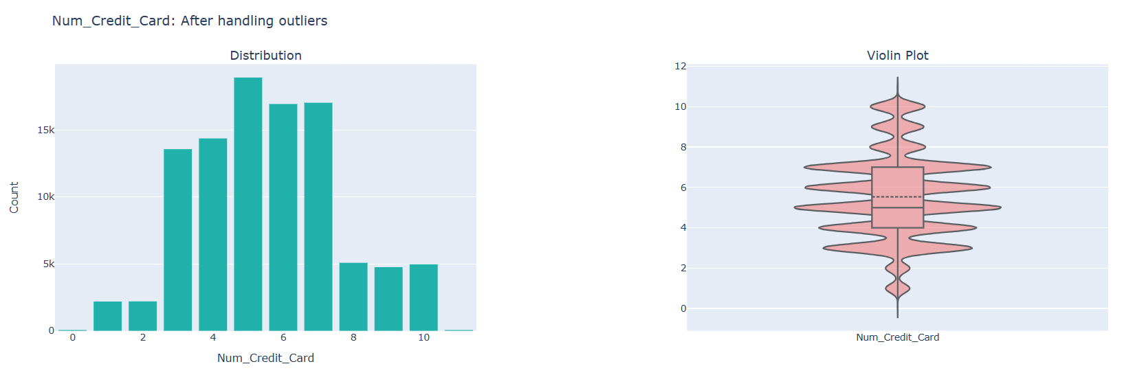
Outliers w.r.t. AGE
Outliers w.r.t. Annual Income
Outliers w.r.t. Number credit cards
Before cleaning the Data
Before cleaning the Data
Before cleaning the Data
After Data Cleaning
After Data Cleaning
After Data Cleaning
AGE before cleaning
Minimum Age : 14
Maximum Age : 8698
Unique Values : 1728
After Data Cleaning
Minimum Age : 14
Maximum Age : 56
Unique Values : 43
Before cleaning data
Min value : 7005.93
Max value : 179987.28
Unique Values : 12488
After Data Cleaning
Min value : 14
Max value : 56
Unique : 13235
Before cleaning data
Min value : 0
Max value : 1499
Unique Values : 1179
After Data Cleaning
Min value : 0
Max value : 15
Unique Values : 12

Slide 16

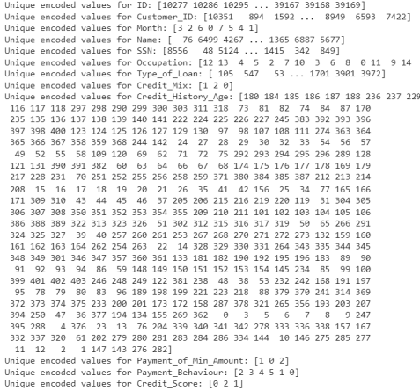
Label Encoding
Output - Encoded Values
Method Used
'Month'
'Occupation'
'Type_of_Loan'
'Credit_Mix'
'Credit_History_Age'
'Payment_of_Min_Amount'
'Payment_Behaviour'
'Credit_Score'
Identify Categorical Features
(select_dtypes)
Apply label encoding
le = LabelEncoder()
Use fit_transform
le.fit_transform(df[column])
Updated data frame with Encoded Values

Slide 17
Feature Selection

Slide 18

Why Use Feature Selection
Efficiency in High-Dimensional Spaces
Focus on Most Relevant Features
Reduction of Overfitting Risks
Simplicity and Interpretability
Computational Efficiency
Flexibility and Adaptability
Model Performance Optimization
This Photo by Unknown Author is licensed under CC BY

Slide 19
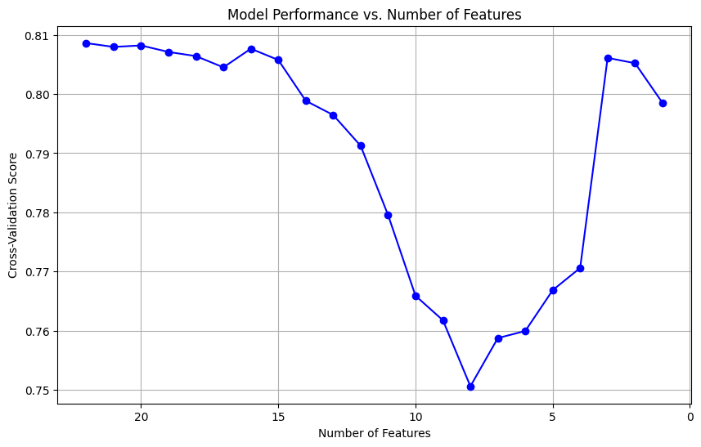
1- Top Down Approach
A gradual decline in accuracy was observed as less important features were removed
Relatively high performance
Minimum accuracy at critical point= 8 features with accuracy 75%
Selected features = 17
2- Importance Score Approach
Importance score calculated for all features
Calculated Mean importance score for all variables
Chosen top features Above Mean importance score

Slide 20
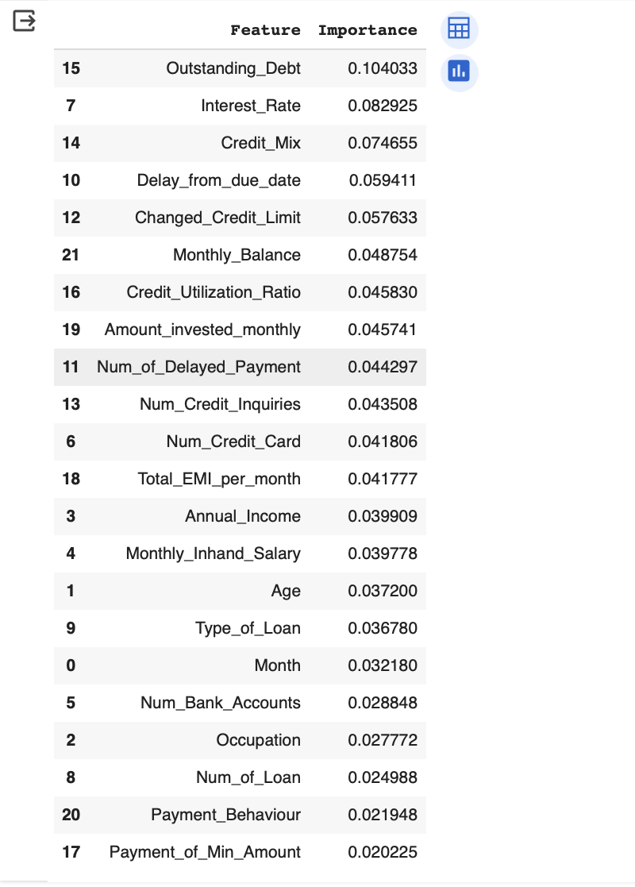
1- Top Down Approach
A gradual decline in accuracy was observed as less important features were removed
Relatively high performance
Minimum accuracy at critical point= 8 features with accuracy 75%
Selected number features = 17
2- Importance Score Approach
Importance score calculated for all features
Calculated Mean importance score for all variables
Chosen top features Above Mean importance score
Selected number of features: 8
Mean= 0.045

Slide 21
Model Construction

Slide 22
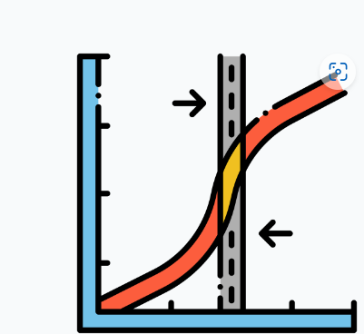
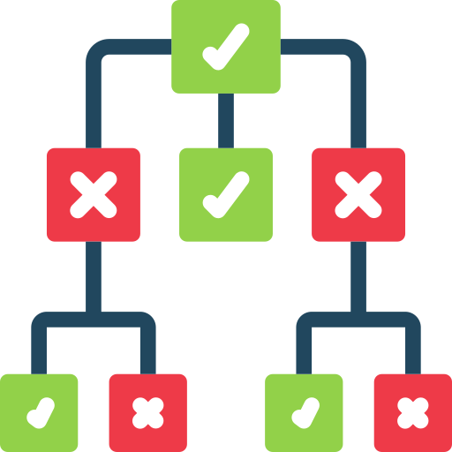

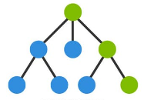
Models Used for the Prediction
Logistic Regression
Fundamental Classification that works well for binary problems, extending to a multi-class scenario with the one-vs-rest approach
Decision Trees
Provide a clear indication of feature importance but can be prone to overfitting, which can be controlled by tuning the depth and minimum samples per leaf.
XG Boost
gradient boosting algorithms which builds trees sequentially such that each new tree corrects errors made by previously trained trees.
Random Forest
An ensemble method that builds multiple decision trees and merges them to get a more accurate and stable prediction

Slide 23
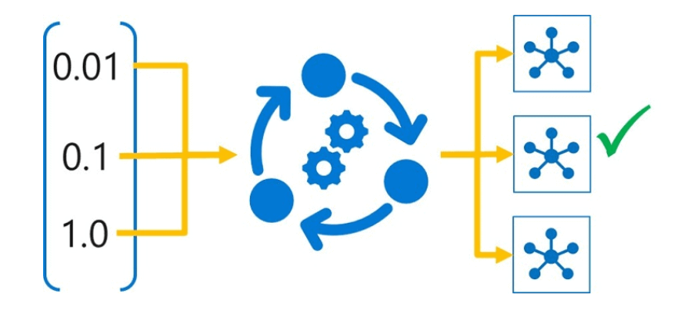





Hyperparameters
Training Data
Model Training
Feature Selection
Train Evaluation Matrices
Processed Data set
Test Evaluation Matrices
Testing Data
Model

Slide 24
Model Evaluation

Slide 25
Model Evaluation - Choice of Metric
Model | Accuracy | Recall | Precision | F1 Score
Random Forest | 0.81 | 0.80 | 0.78 | 0.79
XGBoost | 0.78 | 0.77 | 0.79 | 0.78
Decision Tree | 0.71 | 0.70 | 0.68 | 0.69
Logistic Regression | 0.54 | 0.53 | 0.51 | 0.52
Recall is Prioritized over other metric. Why?
Cost of misclassifying a bad credit risk as good (false negative) could be significantly higher than the reverse

Slide 26
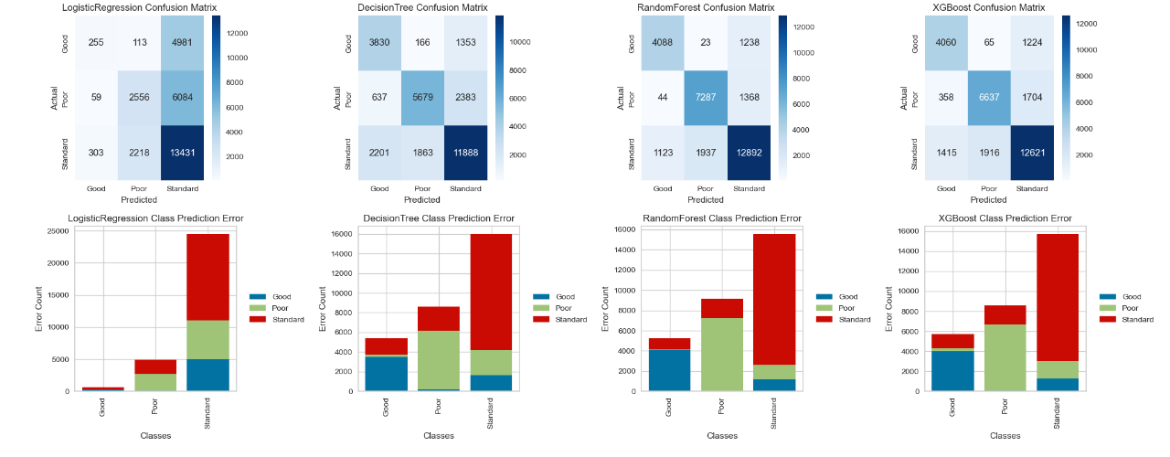
Model Evaluation - Visualization

Slide 27
Thank you

Slide 28
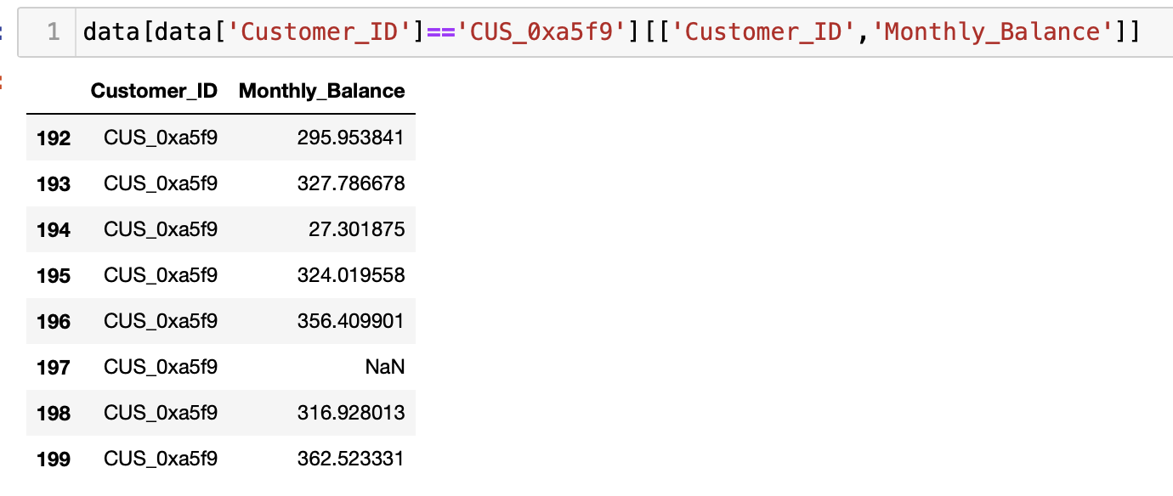
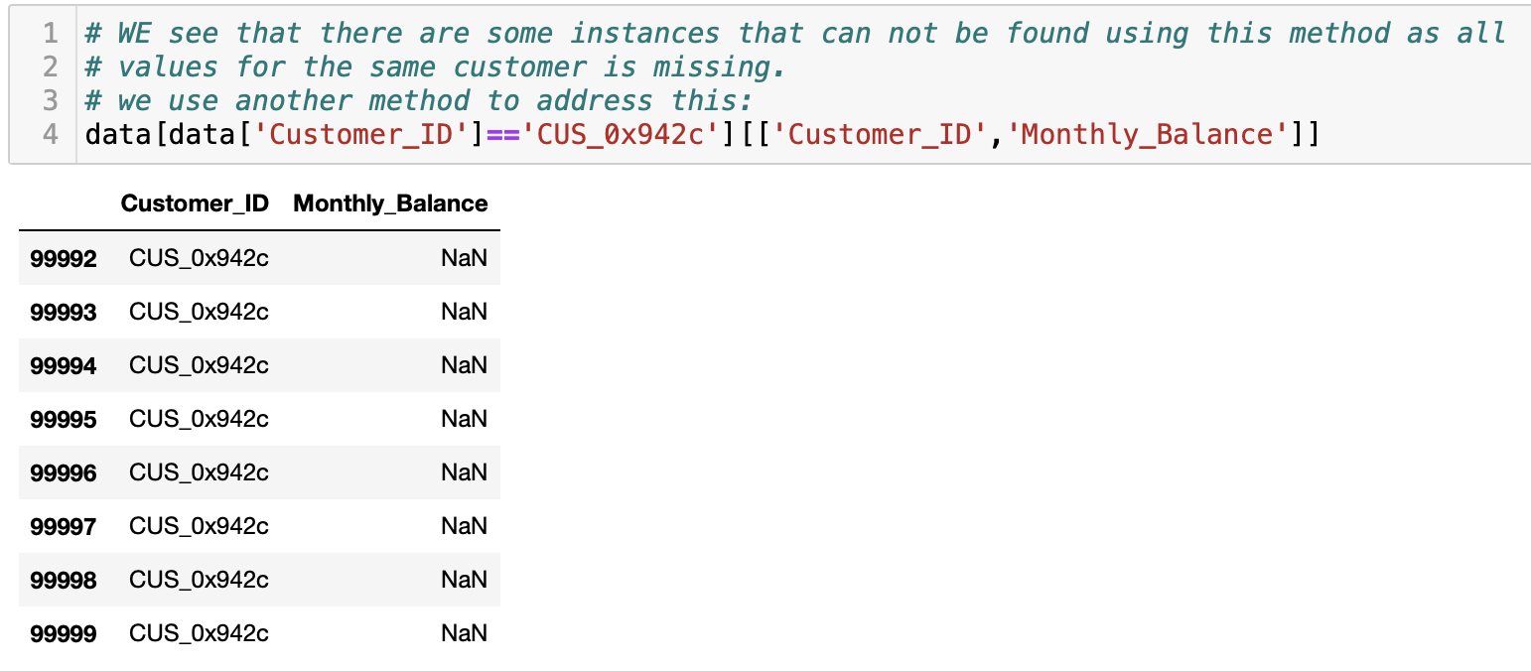
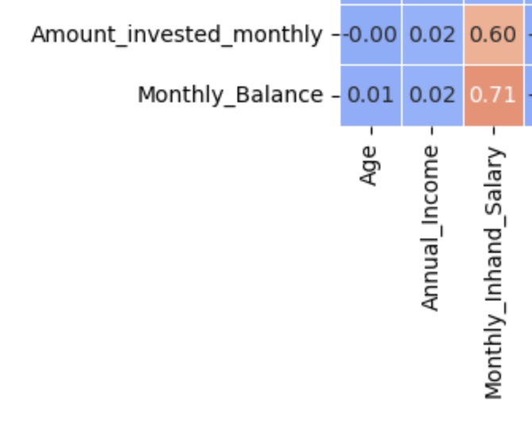
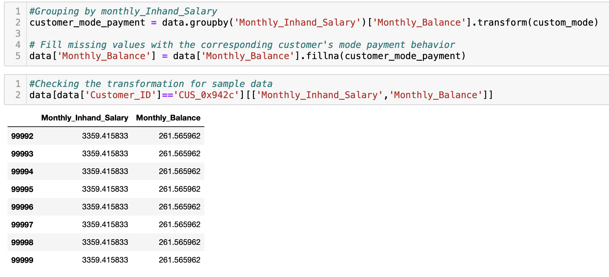
Appendix- hidden slides
Replace missing values with mean:
Missing values can not be addressed
Find highest correlated column
Group based on Monthly_inhand_salary and replace missing values with mode

